Slide 1
Bank Customer’s Engagement Level Report Analysis

Slide 2
Content Outline
I.
Problem Definition
II.
Timeline Description
III.
Variable Creation for RFM
IV.
DV Creation
V.
Business Analysis
VI.
Application Solution
VII.
Extra : Data Visualization

Slide 3
I. Problem Definition

Slide 4

What is the Business challenge ?
Optimize the marketing and customer service strategies based on the clients engagement levels
Goal: Create a Global score showing the engagement level for each client by analyzing
Website visits profiles
Products purchasing patterns
Emails opening numbers
Others engagement metrics

Slide 5
Data Science Definition
Learning from training dataset (2018)
Predicting data output variables (2019)
Classification
Supervised
High Engagement level
Low Engagement level

Slide 6
II. Timeline Description

Slide 7
Timeline
Step 1
Split the datasets into 3 timeframes
From 1/01/2018 till 30/06/2018
From 1/07/2018 till 31/12/2018
From 1/01/2019 till 1/06/2019
Step 2
Perform the following actions on each datasets
 | Jan-Jun 2018 | Jun-Dec 2018 | Jan-Jun 2019
Using IVS of 2018 1st half to calculate DV for next period
Train/Test the model on this period of time. Then use the IV’s for this period to predict DV for next period
Getting predictions for 2019 1st 6 months

Slide 8
III. Variable Creation for RFM Model

Slide 9
Based on the Movement Table
 | Recency | Frequency | Monetary
Description
Last Transaction Date
Total Number of Transactions
Total sum of Transactions
Example based on first half of 2018:
Customer ID | Last Transaction Date | Total Number of Transactions | Total Sum of Transactions
1000 | 15/05/2018 | 8 | 2500 USD
1001 | 12/03/2018 | 6 | 1230 USD

Slide 10
IV. DV Creation

Slide 11
Theory Behind Dependent Variable
Step 1 | Monthly coefficients creation for Recency, Frequency and Monetary Values (As Previously Explained)
Step 2 | K-Means clustering to classify the observations(not customers) into groups
Step 3 | Binary classification
Step 4 | Using the Probabilities to create final engagement score

Slide 12
RFM
Step 1 | We Created monthly coefficients for Recency, Frequency and Monetary Value
Recency
Days since last order
(on monthly basis)
Frequency
Number of orders per month
Monetary Value
Average of the order per month
Example:
Customer ID | Month | Recency | Frequency | Monetary value
3756 | March | 12 | 10 | 13 USD
3731 | February | 48 | 14 | 120 USD

Slide 13
Cluster Distribution
Step 2 | Clustering to classify the observations into groups
Cluster name | Mean of frequency
1st Cluster: | 3
2nd Cluster: | 19
3rd Cluster: | 45
Cluster name | Mean of monetary value
1st Cluster: | 89
2nd Cluster: | 1,132
3rd Cluster: | 11,892
Cluster name | Mean of recency
1st Cluster: | 135
2nd Cluster: | 131
3rd Cluster: | 13
Later we summed the clusters per observation (month-customer) and averaged the coefficient to per customer form and got DV
Example:
Customer ID | DV
3731 | 2.210526
3756 | 1.211111
*Range for New_Coefficient= 0-4

Slide 14
Engaged Customer Definition
Step 3 | Binary classification
We created final DV by setting following conditions:
If DV is more than 2 | 1 (Engaged)
Else | 0 (Non engaged)
Example:
Customer ID | DV | Binary DV
3756 | 1.211111 | 0
3731 | 2.210526 | 1

Slide 15
Modeling
Step 4 | Using the probabilities to create final engagement score
Engagement score
Highly not engaged | x is lower than 0.2
Not engaged | x is greater than or equal to 0.2 and lower than 0.4
Average | x is greater than or equal to 0.4 and lower than 0.6
Engaged | x is greater than or equal to 0.6 and lower than 0.8
Highly engaged | x is greater than or equal to 0.8 and lower than 1
Where x is the probability of being engaged
Example:
Customer ID | DV from clustering for current 6 months | Probability of belonging to class 1 in next 6 months | Engagement status
3731 | 1 | 0.72 | Engaged
3756 | 0 | 0.59 | Average

Slide 16
V. Business
Analysis

Slide 17
Comparison between Clusters (1)
Variable Description | Highly Engaged | Engaged | Average | Not Engaged | Highly Not Engaged
Average Number of Transactions | 0.61 | 1.70 | 3.03 | 5.09 | 14.5
Average Monetary Value of Transactions | 212.2 | 249.5 | 286.5 | 290.3 | 99.3
Business Suggestion:
Targeted offers for low engaged customers (ex: Buy 2 get one for the price of 50%)

Slide 18
Comparison between Clusters (2)
Variable Description | Highly Engaged | Engaged | Average | Not Engaged | Highly Not Engaged
Average Number of buying using Cash | 0.30 | 1.18 | 2.30 | 4.11 | 13.5
Average Number of times of withdrawing liquid money into cash | 0.006 | 0.032 | 0.062 | 0.159 | 0.562
Business Suggestion:
Market and promote paying by card compared to cash:
Flexible Installment Plans
Lower Interest Rates
Loyalty programs and Bonus on upcoming purchases

Slide 19
VI. Results are shared on the Shiny App

Slide 20
VI. Most
important variables

Slide 21
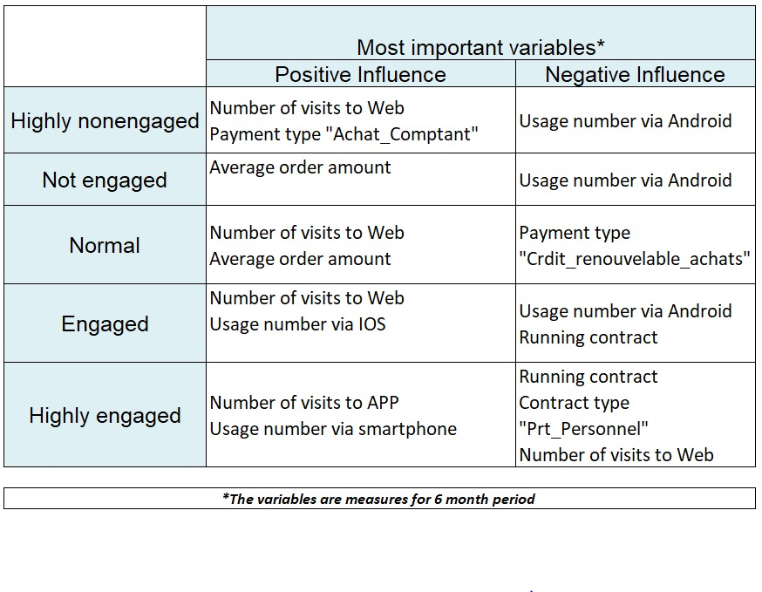

Slide 22
VII. Data Visualization

Slide 23
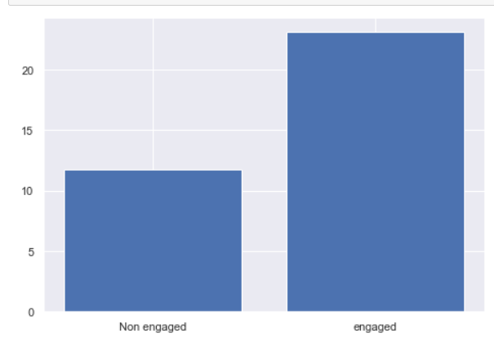
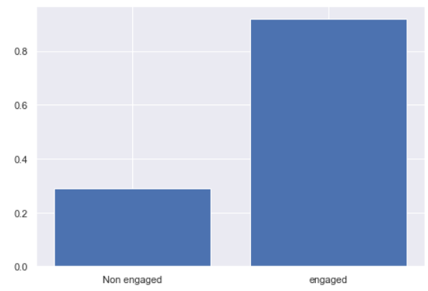
Data Visualization (1)
 | Binary DV Classification
Average number of visits to APP
Average number of visits to Web

Slide 24
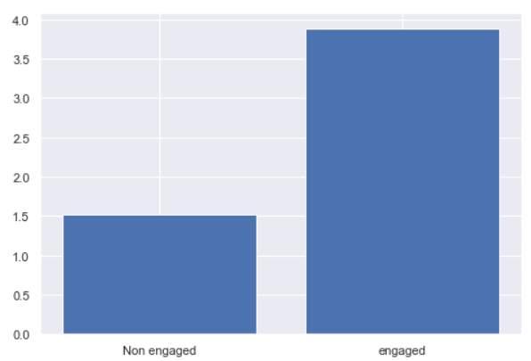
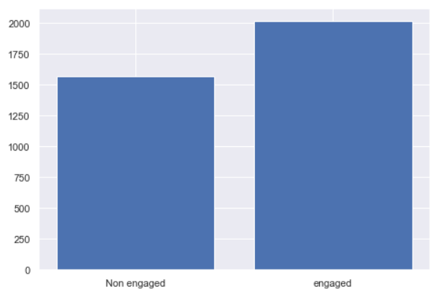
Data Visualization (2)
 | Binary DV Visualization
Average number of contacts
Average amount of order

Slide 25
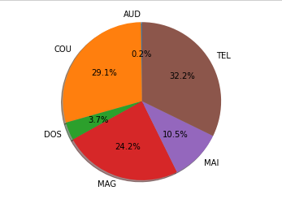
Data Visualization (3)
Contacts Entrants Table
Pie chart showing the distribution of which media channels were used

Slide 26
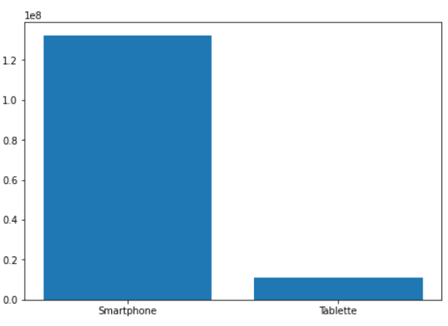
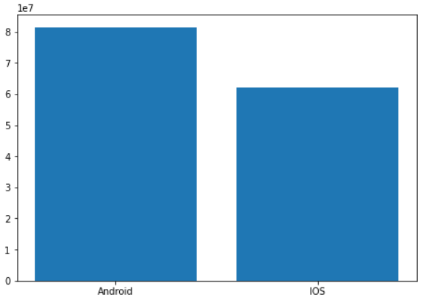
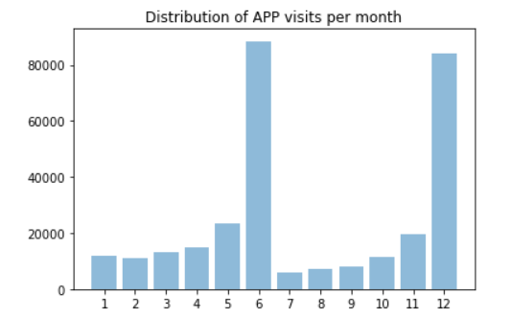
Data Visualization (4)
Navigation APP Table
Platform Repartition
Operating System Repartition
June and December are clearly the most popular

Slide 27
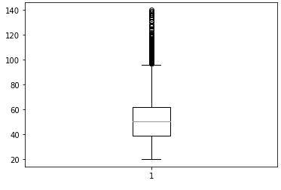
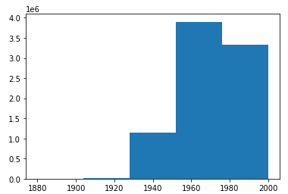
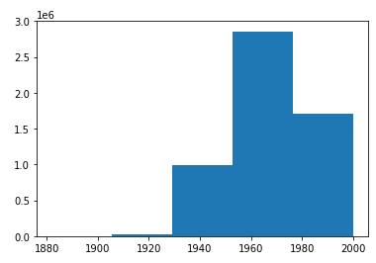
Data Visualization (5)
Base Client Table
Age distribution of all the clients
Distribution of age for 2018
Distribution of age for 2019
2047 clients older than 100!

Slide 28
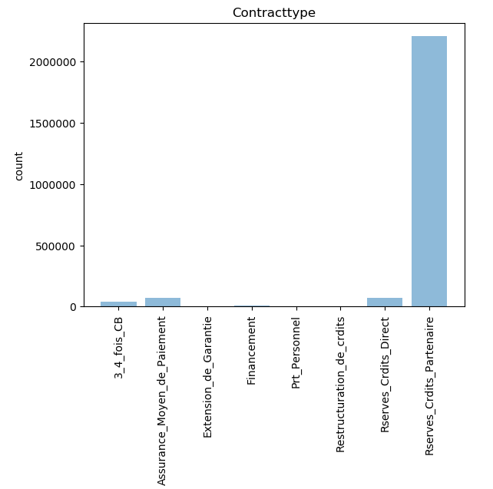
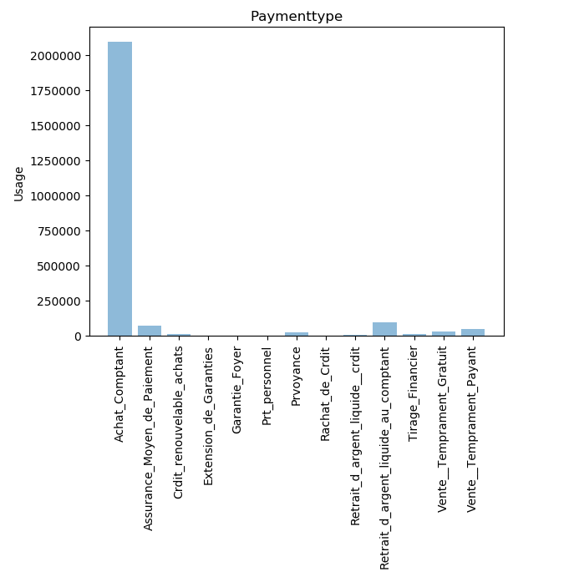
Data Visualization (6)
Mouvement de Production Table
Distribution of Contracttype
Distribution of Paymenttype

Slide 29
THANK YOU

